Slide 1
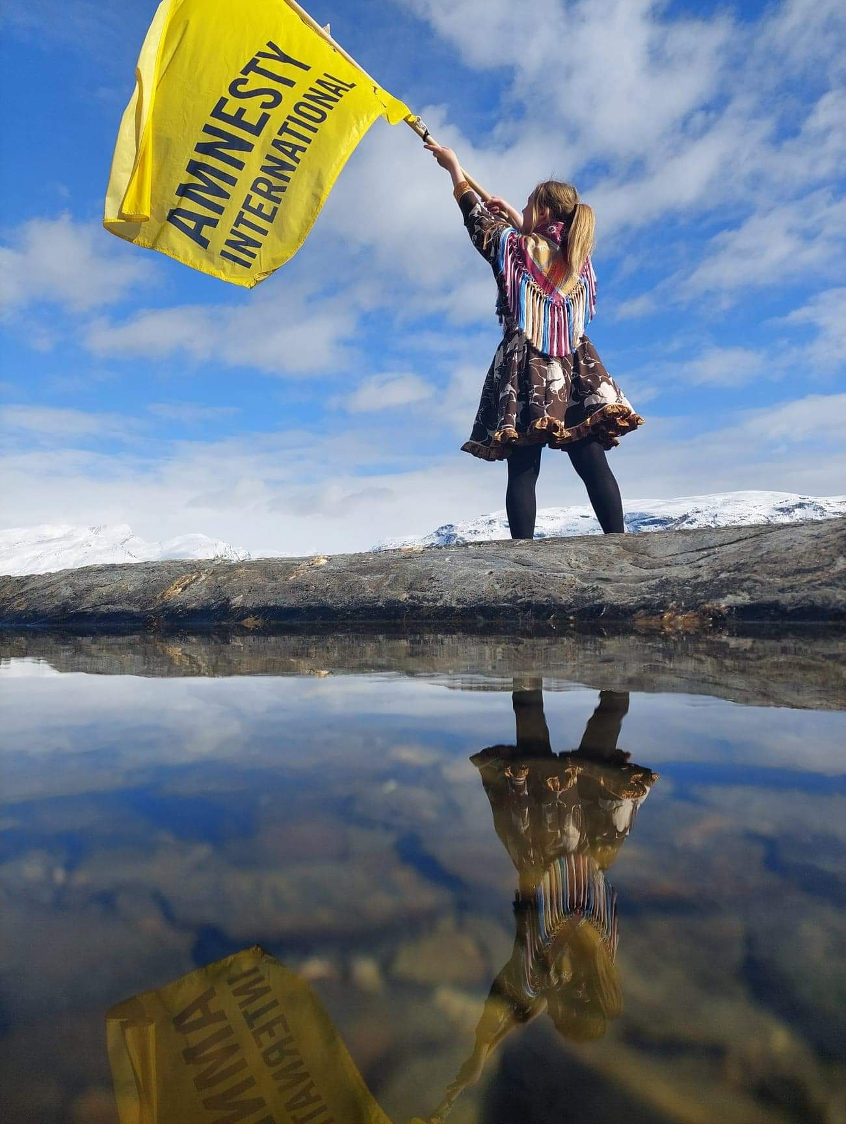

Notes:
(Do you as a teacher wish to contact Amnesty International about this human rights education? Contact us at: opplaering@amnesty.no)
You and your pupils will now use human rights education from Amnesty International.
You might be wondering who Amnesty is?
Amnesty International is the worlds largest human rights organisation, in which all participants, people like you and me, contribute to protecting our human rights. The organisation was created in 1961 and has developed into a global movement which consists of more than 8 million members and supporters from all over the world. They could be 13 or 100 years old, everyone can contribute. Together we stand up for human rights for everyone. No matter what. Always.

Slide 2

HUMAN RIGHTS DIALOGUE
1
Energizer
3
Dialogue activity about racism and discrimination
2
What are human rights?
4
Summary
Notes:
The activity consists of four parts:
An energizer to create postive energy in the classroom
A short introduction to human rights
A dialogue activity in which pupils will actively participate
A summary in which pupils discuss how they themselves can prevent racism and discrimination from happening.

Slide 3
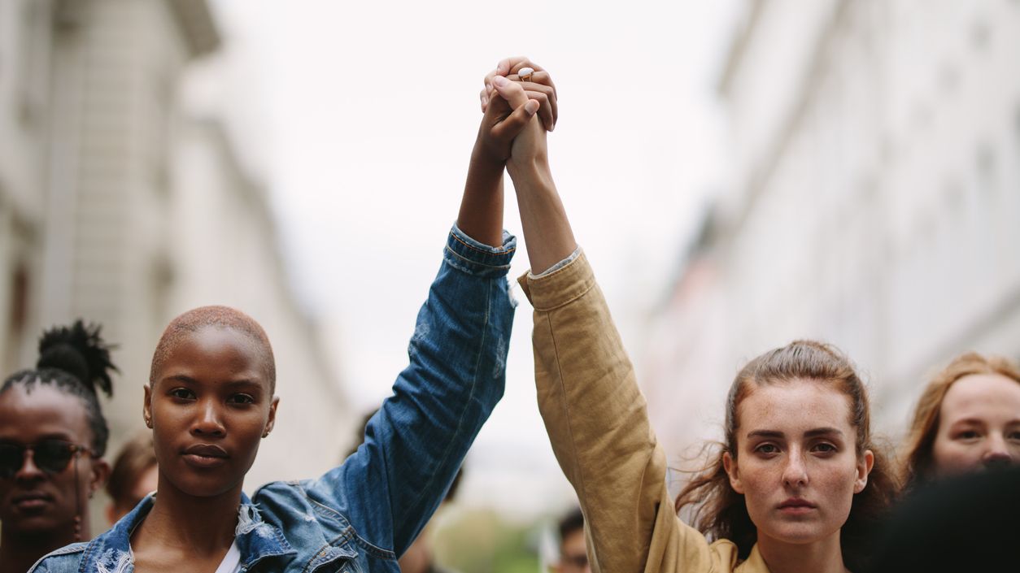
ENERGIZERS KEEP THE SURROUNDING ALIVE, BE AN ENERGIZER ALL DAY LONG
Notes:
Energizer suggestion:
The counting game:
Divide pupils into pairs. First they will count to three as such; Person A says 1, person B says 2, person A says 3, person B says 1, person A says 2, person B says 3. After having done this a few times they will switch out the number 2 with a clap of their hands. So, person A says 1, person B claps, person A says 3, person B says 1, person A claps, person B says 3 etc.

Slide 4
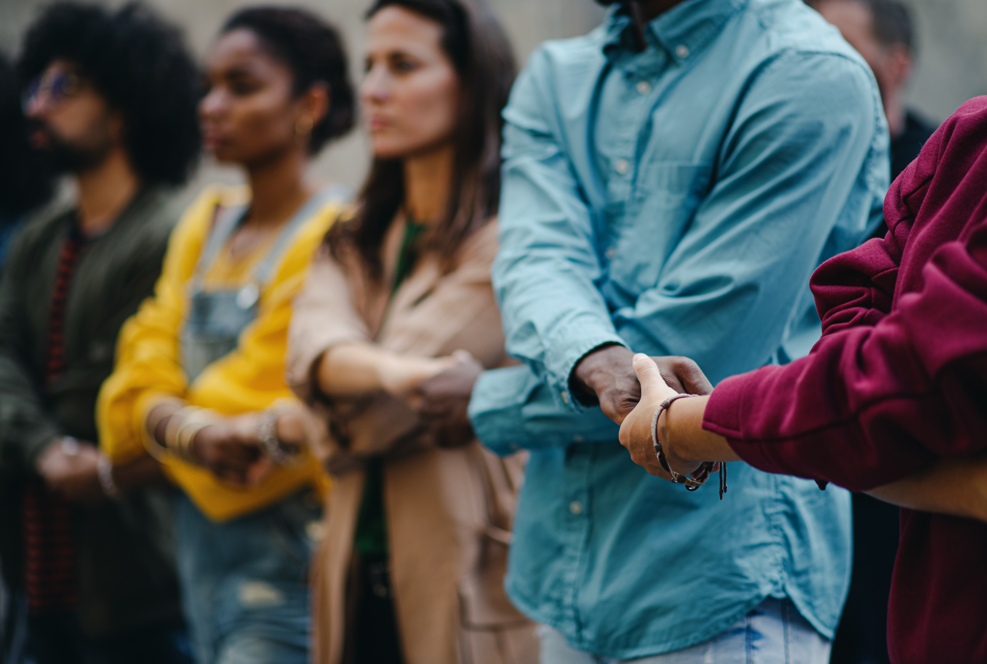
RACISM AND DISCRIMINATION
Notes:
Let the students make some general reflections about the topic. Ask: What is the first thing you think of when you see the topic ‘racism and discrimination’?
Ask follow up questions to their reflections, such as; «How is the situation in Noway?», «Do you have any experience with this topic?»

Slide 5




HUMAN RIGHTS
A short introduction
YOUR
HUMAN
RIGHTS
What are human rights?
Your human rights
Notes:
Ask the students what they know about their human rights.
Show the video: (43) What are Human Rights? – YouTube
After watching the video they can look at their human rights (click on “Your human rights”) in depth to find those that regard the topic racism and discrimination. Which do they find most relevant? Get the answers in plenary. Many articles are indirectly related to the topic. Highlight articles 1, 2 and 7.
Article 1: All human beings are born free and equal
Article 2: Everyone is equal regardless of race, color, sex, language, religion, politics or place of birth.
Artikkel 7: We are all equal before the law

Slide 6
DIALOGUE ABOUT
RACISM AND DISCRIMINATION
What is a dialogue?
Rules for the dialogue
Suggestions for follow-up questions
Notes:
(In this part the pupils must be divided into groups if they are more than six individuals)
Present the guidelines for the dialogue (these can also be printed and handed out), and highlight the importance of listening, respecting and participating in the conversation. The topic may be sensitive for some and everyone should have the opportunity to participate. Se the guidelines for the conversation in the next slide.
Explain the activity:
The pupils will talk and share their opinions about a statement. There is no one right answer to the statement. It is meant as the frame within which the dialogue will be held.
The dialogue-cards which will be presented during the activity by the teacher (moderator) will highlight the statement from different perspectives and are meant to give the pupils new insight into the topic.
Present the guidelines and highlight the importance of listening, respecting and participating in a good dialogue.
You can hand out the guidelines or show the Powerpoint slide.
You can hand out or show the suggested follow-up questions.
Encourage your pupils to ask questions, be curious and participate in the conversation.
Check with them if anything is unclear.

Slide 7
Racism and discrimination
DIALOGUE GUIDELINES
Respect each other and each other’s opinions.
Listen to the other participants’ point of views.
Contribute to the conversation with your own point of view.
Feel free to ask follow-up questions during the dialogue.
This is NOT a debate. You are not meant to convince others of your opinions, but to share your thoughts as well as listen to and try to understand others’ opinions.
Notes:
Read the guidelines out loud for the pupils and underline the importance of understanding and respect in the conversation.
Some may feel that it is uncomfortable to talk about the topic because they do not represent a minority or maybe they are the only minority individual in the class, that is why it is important to have a good dialogue.

Slide 8
Racism and discrimination
SUGGESTIONS FOR FOLLOW-UP QUESTIONS
Why do you say that?
What do other people think of your point of view?
Are there exceptions to your point of view?
Could you elaborate on your thoughts?
Notes:
Read out loud for the pupils. Specify that it is up to the pupils themselves to create and define the dialogue in the group. It is up to you as moderator to adjust the time and content, and adjust the activity accordingly to the group.
Remember that the dialogue can go in different directions, and that it is the pupils who should carry out the conversation. You, the moderator, can help when needed.

Slide 9
Racism and discrimination
Rasisme og diskriminering
STATEMENT
A world without racism is possible
Notes:
You (moderator) choose ONE statement. The remaining statement which you do not wish to use can be moved to the bottom of the Powerpoint.
Place the statement-card on each group’s table or show it on the big screen. Give the pupils a few minutes to discuss the statement between themselves. Is the statement true? Why/why not?
Point out that the pupils should keep this statement in mind when they discuss the dialogue-cards following.
For the teacher/moderator: this statement is meant to promote an understanding of the fact that racisms exists on different levels, and why it is important to combat this. The goal is that the pupils, throught the dialogue, relect around and increase their understanding of
What racism is
Which groups are subject to it
How to prevent racism and prejudice in ones own circle

Slide 10

Racism and discrimination
Rasisme og diskriminering
STATEMENT
Everyone discriminates
Notes:
You (moderator) choose ONE statement. The remaining statement which you do not wish to use can be moved to the bottom of the Powerpoint.
Place the statement-card on each group’s table or show it on the big screen. Give the pupils a few minutes to discuss the statement between themselves. Is the statement true? Why/why not?
Point out that the pupils should keep this statement in mind when they discuss the dialogue-cards following.
For the teacher/moderator: This statement proposes that discrimination is a normal phenomenon and that students themselves may have some prejudices through which they discriminate. The goal of using this statement is for the students to have increased their knowledge of what discrimination is.
Which groups in society are often subject to discrimination.
How we can prevent discrimination and prejudice in ourselves as well as others.

Slide 11

Racism and discrimination
Rasisme og diskriminering
CASE
«Miryam» is a woman of Iranian descent, born and raised in Lillehammer. She participates at an event at the local library, and an unknown woman compliments her on her Norwegian pronunciation.
How may Miryam react to this comment?
Notes:
The purpose of CASE-cards is to allow pupils to step into different situations in which the context of the case may decide whether racism or discrimination has occurred.
This may be a difficult task for many as they may never have experienced being on the receiving end of racism and discrimination.
Follow-up questions:
The receiver may interpret the comment differently than how the speaker meant it. How may the speaker’s actions be interpreted by the receiver?
Why do you think this situation may be interpreted as discriminatory by some?
What do you think the unknown woman is basing her prejudices on?
The speaker may have the best of intentions, but would she have said the same if she had knowledge of the multiculturalism in Norway?

Slide 12
Racism and discrimination
Rasisme og diskriminering
CASE
«Sara» is a 25 year old woman of Somalian descent. While in airport security at Gardemoen a security guard asks her to take off her hijab in public for closer inspection.
To which extent do you think this situation is about security?
Notes:
This dialogue card is based on a true story from Evenes airport in 2018, where it was concluded that this request was a breach of Avinors guidelines. (Source: nyheter, flyplass | Muslimsk kvinne måtte fjerne hijaben i sikkerhetskontrollen på Evenes (an.no).
In such a situation the hijab should not be removed in the security check line. One can check by touching the outsides of the hijab. If strictly necessary, the hijab may be removed in a private space, and this must be done with diginity.
Follow-up questions:
Mention freedom of religion – do you think the security guard was aware of the woman’s religious beliefs?
What do the circumstances of this situation tell us? What was the tone of the security guard? Were they aware of protocol? May stereotypes have influenced this situation?
Do you have underlying prejudices that impact the way you treat people?
Feel free to ask how the participants may have reacted if they witnessed this situation.

Slide 13
Racism and discrimination
Rasisme og diskriminering
CASE
A young boy stops you in the streets and asks to borrow your phone since his own has run out of battery.
Would you let him borrow it?
Notes:
This scenario is meant to create reflection around our own values in such a situation. Underline that there are no right or wrong answers.
Follow-up questions:
Do you think ethnicity or skin color have an impact on whether or not you are willing to help a stranger?
Would it be important to you whether or not the boy spoke Norwegian?
In which way may prejucides play a role in such a situation?

Slide 14
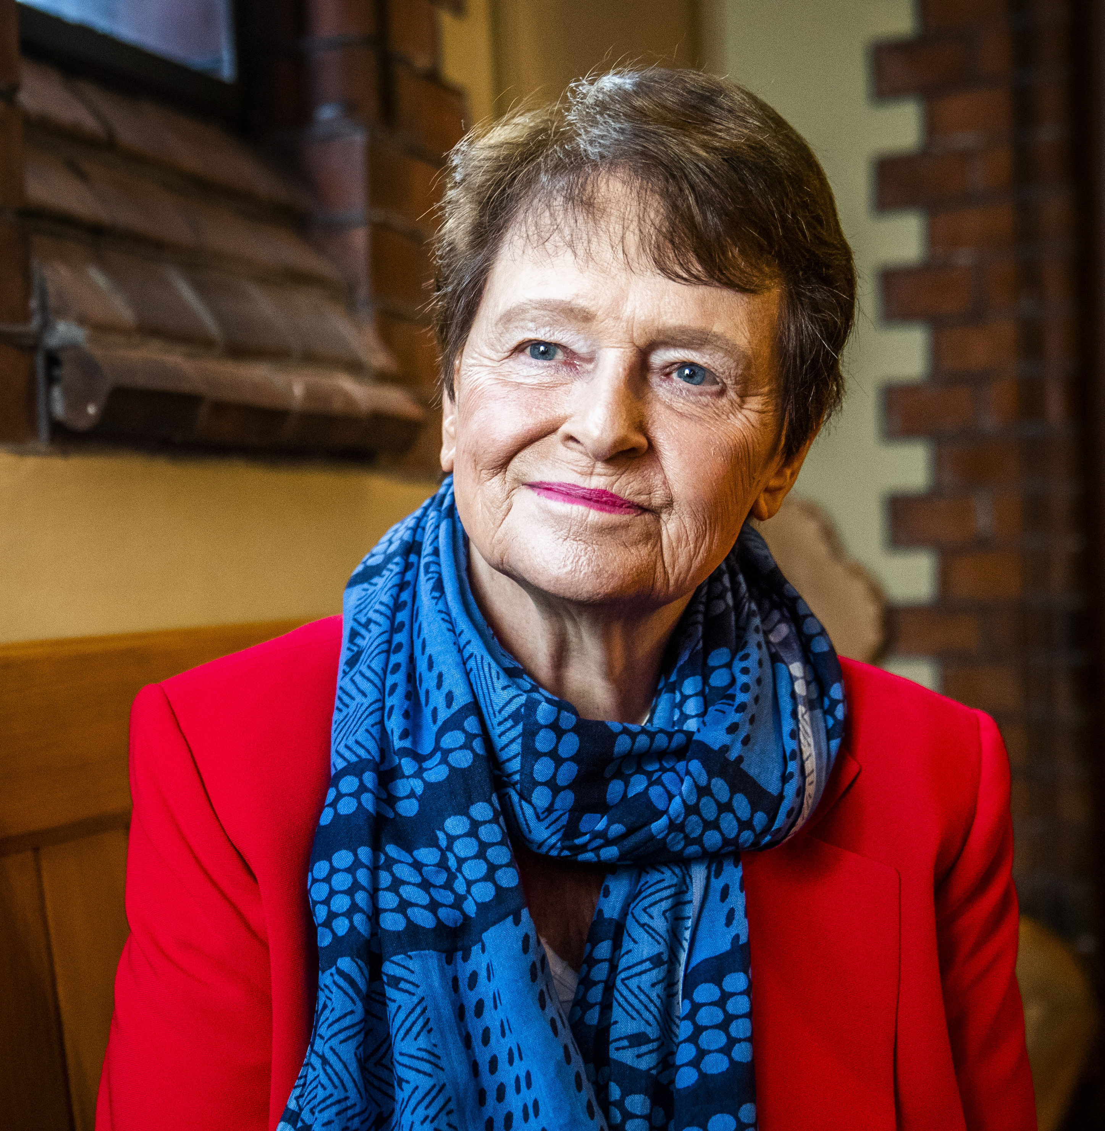
Racism and discrimination
Rasisme og diskriminering
QUOTE
«It is typically Norwegian to be good»
– Gro Harlem Brundtland, 1992
What does it mean to be typically Norwegian?
© snl 2020
Notes:
This card’s purpose is to get students to start reflecting around Norwegian values, as well as common stereotypes.
Follow-up questions:
Can you mention some things which you think are typically Norwegian?
What makes something «typically Norwegian»? (Traditions? Values? Attitudes?)

Slide 15
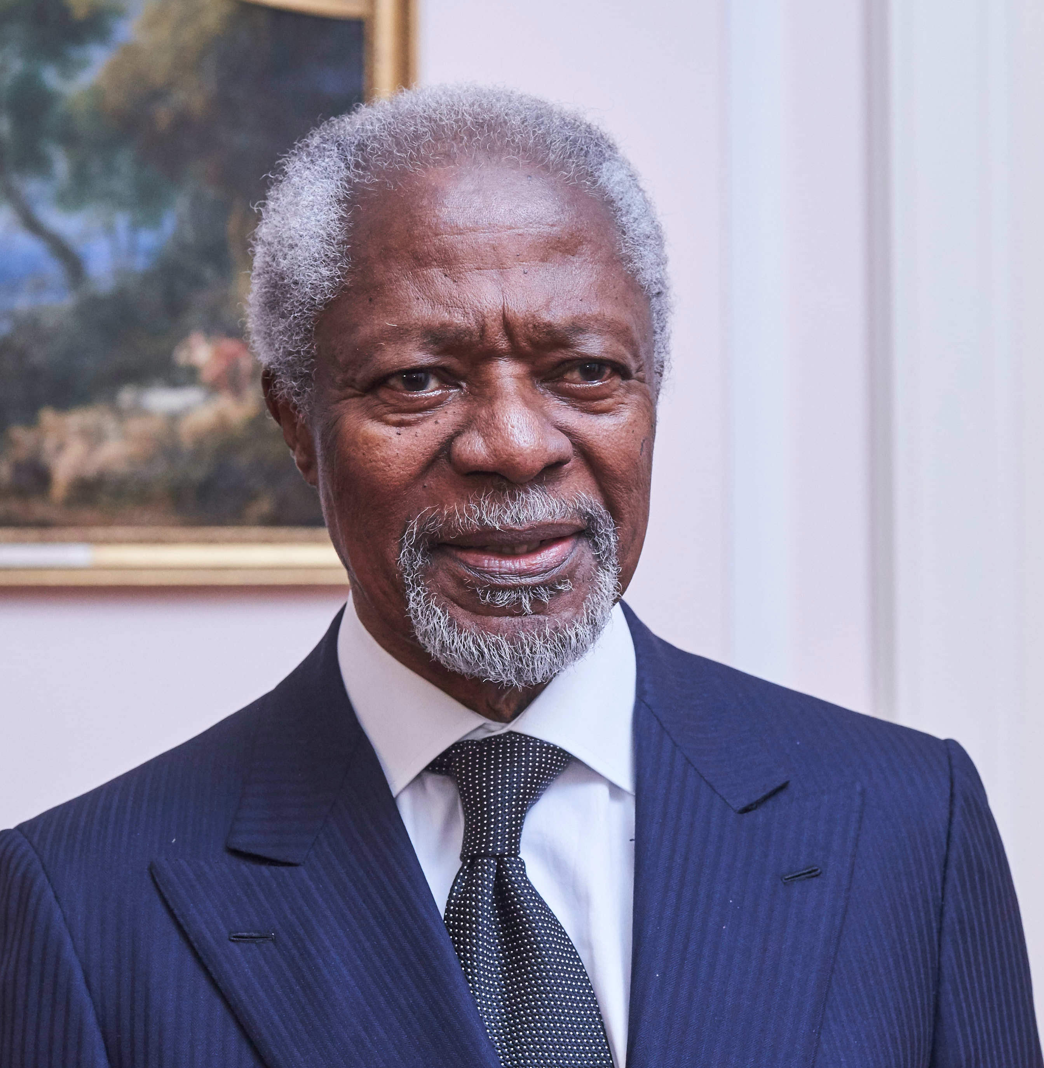
Racism and discrimination
Rasisme og diskriminering
QUOTE
«Ignorance and prejudice are the handmaidens of propaganda. Our mission, therefore, is to confront ignorance with knowledge, bigotry with tolerance, and isolation with the outstretched hand of generosity. Racism can, will, and must be defeated»
– Kofi Annan, the 7th secretary general of the UN
© snl 2020
How do interpret this quote?
Notes:
It is important to give this quote special attention because it mentions 3 aspects of preventing racism. Feel free to referece to Kofi Annas anti-racism efforts.
The three central aspects of this quote are:
Fighting ignorance with knowledge
Bigotry with tolerance
Isolation with generosity
Allow the participants to elaborate on these different aspects.
Do you think it is possible to realize Annan’s vision of a world free from racism?
Why do you think he suggests knowledge, tolerance and generosity as methods to combat racism?
In which way can isolation be a factor in the existence racism?
Do you know of any measures to combat racism in your own community?

Slide 16
Racism and discrimination
Rasisme og diskriminering
PERSONAL STORY
Abubakar Hussain
«When I was seven years old, I invited my entire class to my birthday.
Only two came»
Why do you think only two children came to the party?
Antirasistisk.no/takk
Notes:
May be worth mentioning that Hussain is now an adult, and that this happened 20 years ago.
Follow-up questions:
How would you feel if this happened to you?
Hussain is an adult now, do you think things are different for minority children today?
Do you think children have prejudices?
How do children develop prejudices towards other people?

Slide 17
Racism and discrimination
Rasisme og diskriminering
PERSONAL STORY
Adriana Pooja Joseph
«I received a written response from a professor who meant that me being a foreigner was a handicap»
What to you think the professor meant by his statement?
Antirasistisk.no/takk
Notes:
Follow up questions:
• Is this a racist or discriminatory response?
• What would you do if you received an evaluation like this on your schoolwork?
• What is such an evaluation based on? (Stereotypes? Prejudices?)

Slide 18
Racism and discrimination
Rasisme og diskriminering
PERSONAL STORY
Tobias Bashevkin
«As a child, people threw stones at me because I was Jewish»
How do you think such an experience may impact a child?
Antirasistisk.no/takk
Notes:
Follow-up questions:
• What are your first thoughts regarding this story?
• Do you know anything about Jewish people’s status in Norway?
• How would you react if you witnessed this situation?

Slide 19
Racism and discrimination
Rasisme og diskriminering
RIGHT OR WRONG
«Where are you from, originally?»
«Are you forced to wear the hijab by your family?»
«Can I touch your hair?»
How do you interpret these questions?
Notes:
Follow-up questions:
Have you heard, asked or experienced such questions?
Why do you think people ask such questions?
How would you react if you heard questions such as these?
Does context matter in whether these questions are interpreted as offensive? If yes – explain why.

Slide 20
Racism and discrimination
Rasisme og diskriminering
HAVE YOU
…ever experienced racism or discrimination, or witnessed others being subjected to it?
Notes:
Let all the students reflect on this question, underline the importance of listening if anyone wants to share their serious stories. NB! No one is obligated to answer this question, be considerate that each and everyone of the participants may have experiences which may make this question difficult to answer.
Follow-up questions:
Do you wish to share an experience you have witnessed/been subjected to?
Why do you think it may be difficult to speak up about discrimination you have witnessed or experienced?
What can your school do to make it easier for people to speak up about discrimination?
If you wish to report racism which you have been subjected to or witnessed, you may do that here: Antirasistisk

Slide 21
Racism and discrimination
Rasisme og diskriminering
FACT
A narrow definition of racism is beliefs, attitudes or actions that divide people into categories based upon their (supposed) ethnical background, where some are claimed to have a greater worth than others.
FREEDOM
FOR
ALL
How would you define racism?
@ snl 2020
Notes:
This FACT-card is relatively self-explanatory, but feel free to underline that there are many ways to define racism.
It exists in many forms and does not always concern skin color, but ethnicity as well. Encourage the participants to give examples of minorities that are subject to racism in Norway.
You may contribute with examples if neccessary.
Follow-up questions:
Do you think everyone in Norway has the same definition of racism?
Does it matter who gets to define racism? Why/why not?
Which consequences does racism have for the individual?
Which consequences does racism have for society? Feel free provide examples.

Slide 22
Racism and discrimination
Rasisme og diskriminering
FACT
Discrimination means to treat some differently than others. Individuals may be discriminated against based on their sexual orientation, gender, religion, ethnicity or impaired functioning.
How would you define discrimination?
@ snl 2020
Notes:
The definition card is meant to mark the difference between racism and discrimination. Underline that discrimination can relate to differentiated treatment based on several different factors.
Follow-up questions:
Why do you think people discriminate?
How would you proceed if you experienced discrimination in the classroom?
Why do you think it is difficult to speak out about discrimination?
What can be done to combat different forms of discrimination?
Are there any measures your school can take to combat discrimination to a greater extent?

Slide 23
Racism and discrimination
Rasisme og diskriminering
FACT
Prejudice is a preconceived judgement or opinion which is not grounded in sufficient knowledge.
How do you define prejudice?
@ snl 2022
Notes:
Prejudices are often directed towards social groups to which the person with prejudices does not belong. Such groups may be defined by ethnic or religious belonging, sexual orientation, gender etc. When prejudices are expressed through attitudes it is called discrimination.
The purpose of this card is to let the participants reflect on the function and form of predjudices. The goal is to become aware of ones own prejudices and learn how prejudices may form our actions.
Follow-up questions:
Why does one have prejudices?
What is the difference between negative and positive prejudices?
What may be the consequence of prejudices against a specific social group?
Have you ever encountered prejudice?
Where do you think your own prejudices stem from?
What can one do to get rid of one’s own prejudices?

Slide 24
Racism and discrimination
Rasisme og diskriminering
FACT
Discrimination is a problem in the Norwegian labour market. Norwegian businesses employ an increasing number of immigrants from EU countries, while immigrants from Africa and Asia experience difficulties getting jobs that match their qualifications.
What could be the reason that some are not hired for positions for which they are qualified?
@ snl 2018
Notes:
Follow-up questions:
• It may be easier to hire immigrants from EU-countries than immigrants from outside the EU because of the EEA-co-operation. Why so?
• Do you think the applicant’s surname matters to whether or not they are hired?
• Do you think prejudices play a role in the hiring of immigrants from Eastern parts of the world? Why?

Slide 25
Racism and discrimination
Rasisme og diskriminering
FACT
Since 1999, Jews, Romani, Roma, Kven people and Forest Finns have had the status as national minorities in Norway.
In Norway this status is given to ethnic groups with a longstanding connection to the country, often people who have historically been subjected to discrimination or oppression.
What do you think is the purpose of giving this status to certain groups?
@ snl 2017
Notes:
In 1999 Norway ratified the European councils convention for the protection of national minorities. Even if there is no single definition for national minorities among European countries they usually have in common that the status is given to ethnic groups who have a longstanding connection to the country. Because of this historical connection national minorities differ from other ethnic minorities who have immigrated in more recent times.
Follow-up questions:
Why do you think the European Council made such a convention for the protection of national minorites?
What do you know about these minorities’ historical connection to Norway?
Individuals from these ethnic groups choose whether or not they wish to identify as a national minority or as a part of the Norwegian majority – why do think that is?

Slide 26
Racism and discrimination
Rasisme og diskriminering
DID YOU KNOW
…that The Norwegian Constitution of 1814 had a clause that banned Jews from entering the kingdom of Norway? The clause was removed in 1851 on the initiative of the Norwegian writer Henrik Wergeland.
Why do you think Jewish people were denied entry to Norway during this period?
© Ekeløve-Slydal 2014
Notes:
This card shows the first systematic racist law in Norway (after independence in 1814)
Today Jewish people in Norway have the status as a national minority. They are one of five national minorities in Norway, who were all given this status in 1999. There is no single definition of what a national minority is in European countries. In Norway a national minority is an ethnic group who have been in Norway for over 100 years, and who have historically been subjected to marginalization and assimilation.
Follow-up questions:
What was the background that could lead to such a law?
Do you think Jewish people’s rights in Norway are better today?
Why do you think Jewish people are considered a national minority?
Are there other minorities who experience racism in Norway today?
In which ways can prejudices against a specific ethnic group have global consequences?
More information: Jødenes historie i Norge – Store norske leksikon (snl.no)

Slide 27
Racism and discrimination
Rasisme og diskriminering
LAWS AND TREATIES
The Constitution of the Kingdom of Norway
Paragraph §98 – All are equal before the law.
No human being shall be subject to unreasonable or disproportionate discrimination.
On May 13th 2014 the Norwegian Parliament adopted a new paragraph in §98 of the Constitution. The law prohibits direct and indirect discrimination where the consequences of said actions are more severe for one group than another group. This includes sexual harassment and other kinds of harassment.
Why do you think there exists a consitutional law about discrimination?
© lovdata
Notes:
Follow-up questions:
The Norwegian Constitution has a paragraph which protects people against discrimination. How do you think this is enforced in reality?
Can you think of any examples where this law has not been enforced?
What can be done to ensure better enforcement of the law?

Slide 28
Rasisme og diskriminering
Racism and discrimination
FOR REFLECTION
Prejudices
Discrimination
Racism
Hatecrime
Terrorism
Genocide
How can prejudice develop into genocide?
Notes:
Explain how prejudices may develop into more serious consequences with this scale.
Prejudices are in no way the same as genocide, but genocide is nontheless contingent on the presence of prejudice.
Ask the students to reflect on how serious human rights violations such as terrorism and genocide can be traced back to prejudices.
Follow-up questions:
Do you know of any historical examples of genocide?
How did this historical event start? Did it start abruptly or were there subtle signs building up to the genocide?
What can be done to prevent grave human rights violations such as terrorism and genocide?

Slide 29
Racism and discrimination
Rasisme og diskriminering
FOR REFLECTION
Several places of study practice affirmative action in relations to applications. For instance, the University of Tromsø practice affirmative action which gives people of Northern Norwegian background an advantage when applying to studies.
Is the practice of affirmative action
in workplaces discriminating?
Notes:
Follow-up questions:
• Do you know of any similar examples of such dilemmas?
• Can affirmitive action be seen from different perspectives?
• What do you believe is the best practice?

Slide 30
Racism and discrimination
Rasisme og diskriminering
FOR REFLECTION
Statistics show that:
More than 60 % of Jews sometimes avoid displaying their religious belonging in fear of negative attention.
50 % of Sámi people with a strong sense of belonging to their community have experienced discrimination.
4 out of 10 would not want Roma people as their neighbour.
Are these numbers aligned with your perception of prejudices in Norway?
© Bufdir 2020’
Notes:
Follow-up questions:
• Do these statistics surprise you? Why/why not?
• Would you be alright with a Roma person as a neighbour?
• How can we change these statistics?

Slide 31
Racism and discrimination
Rasisme og diskriminering
FOR REFLECTION
The Sámi people have been subject to discrimination for many years. They were not allowed to keep their religion or their language and were not allowed to own land.
What is today’s situation?
© Ekeløve-Slydal 2014
Notes:
Feel free to reference examples of discrimination against the Sámi people today:
• When papers write about Sámi topics they often have to turn off the comment sections to avoid hate speech against Sámi people.
‘’jævla same’’/ «Fucking Sámi» is a common derogatory term in Norwegian schools.
Follow-up questions:
Why are there prejudices against Sámi people?
What can be the consequences of Sámi language and culture being discriminated against for several generations?
• How can we get rid of prejudices against Sámi people?

Slide 32
Racism and discrimination
LAWS AND TREATIES
The Constitution of the Kingdom of Norway
Paragraph §108
The authorities of the state shall create conditions enabling the Sami people to preserve and develop its language, culture and way of life.
Why do you think there exists a constitutional law about the rights of Sámi people?
© lovdata
Notes:
That Sámi people have special rights that give them more privileges than the majority-Norwegians is a prejudice that many Sámi people encounter. This law secures the Sámi people a council elected by the people (Sámi parliament), the right to be consulted about political decisions which affect their culture or society specifically, and the right to use their own languages. The law was implemented into the Norwegian Constitution in 1988.
Follow-up questions:
What does this law entail in practice?
Are these rights different than any of those held by the majority people in Norway?
Why do you think there exists prejudices about what this law entails?

Slide 33
Racism and discrimination
Rasisme og diskriminering
RIGHT OR WRONG
«Can you joik for us?»
«Do you live in a lavvu all year round?»
«Do you always wear a gákti?»
How do you interpret these questions?
Notes:
Follow-up questions:
Do you interpret these questions as offensive or innocent curiosity?
Why do you think people ask such questions?
How would you react if you heard such questions?
Does context matter in whether these questions are interpreted as offensive? If yes – explain why.
FYI:
Gákti is the Northsámi word for traditional clothes of the Sámi people, known in Norwegian as «kofte».
Lavvu is a conically shaped tent, a traditional Sámi dwelling.

Slide 34
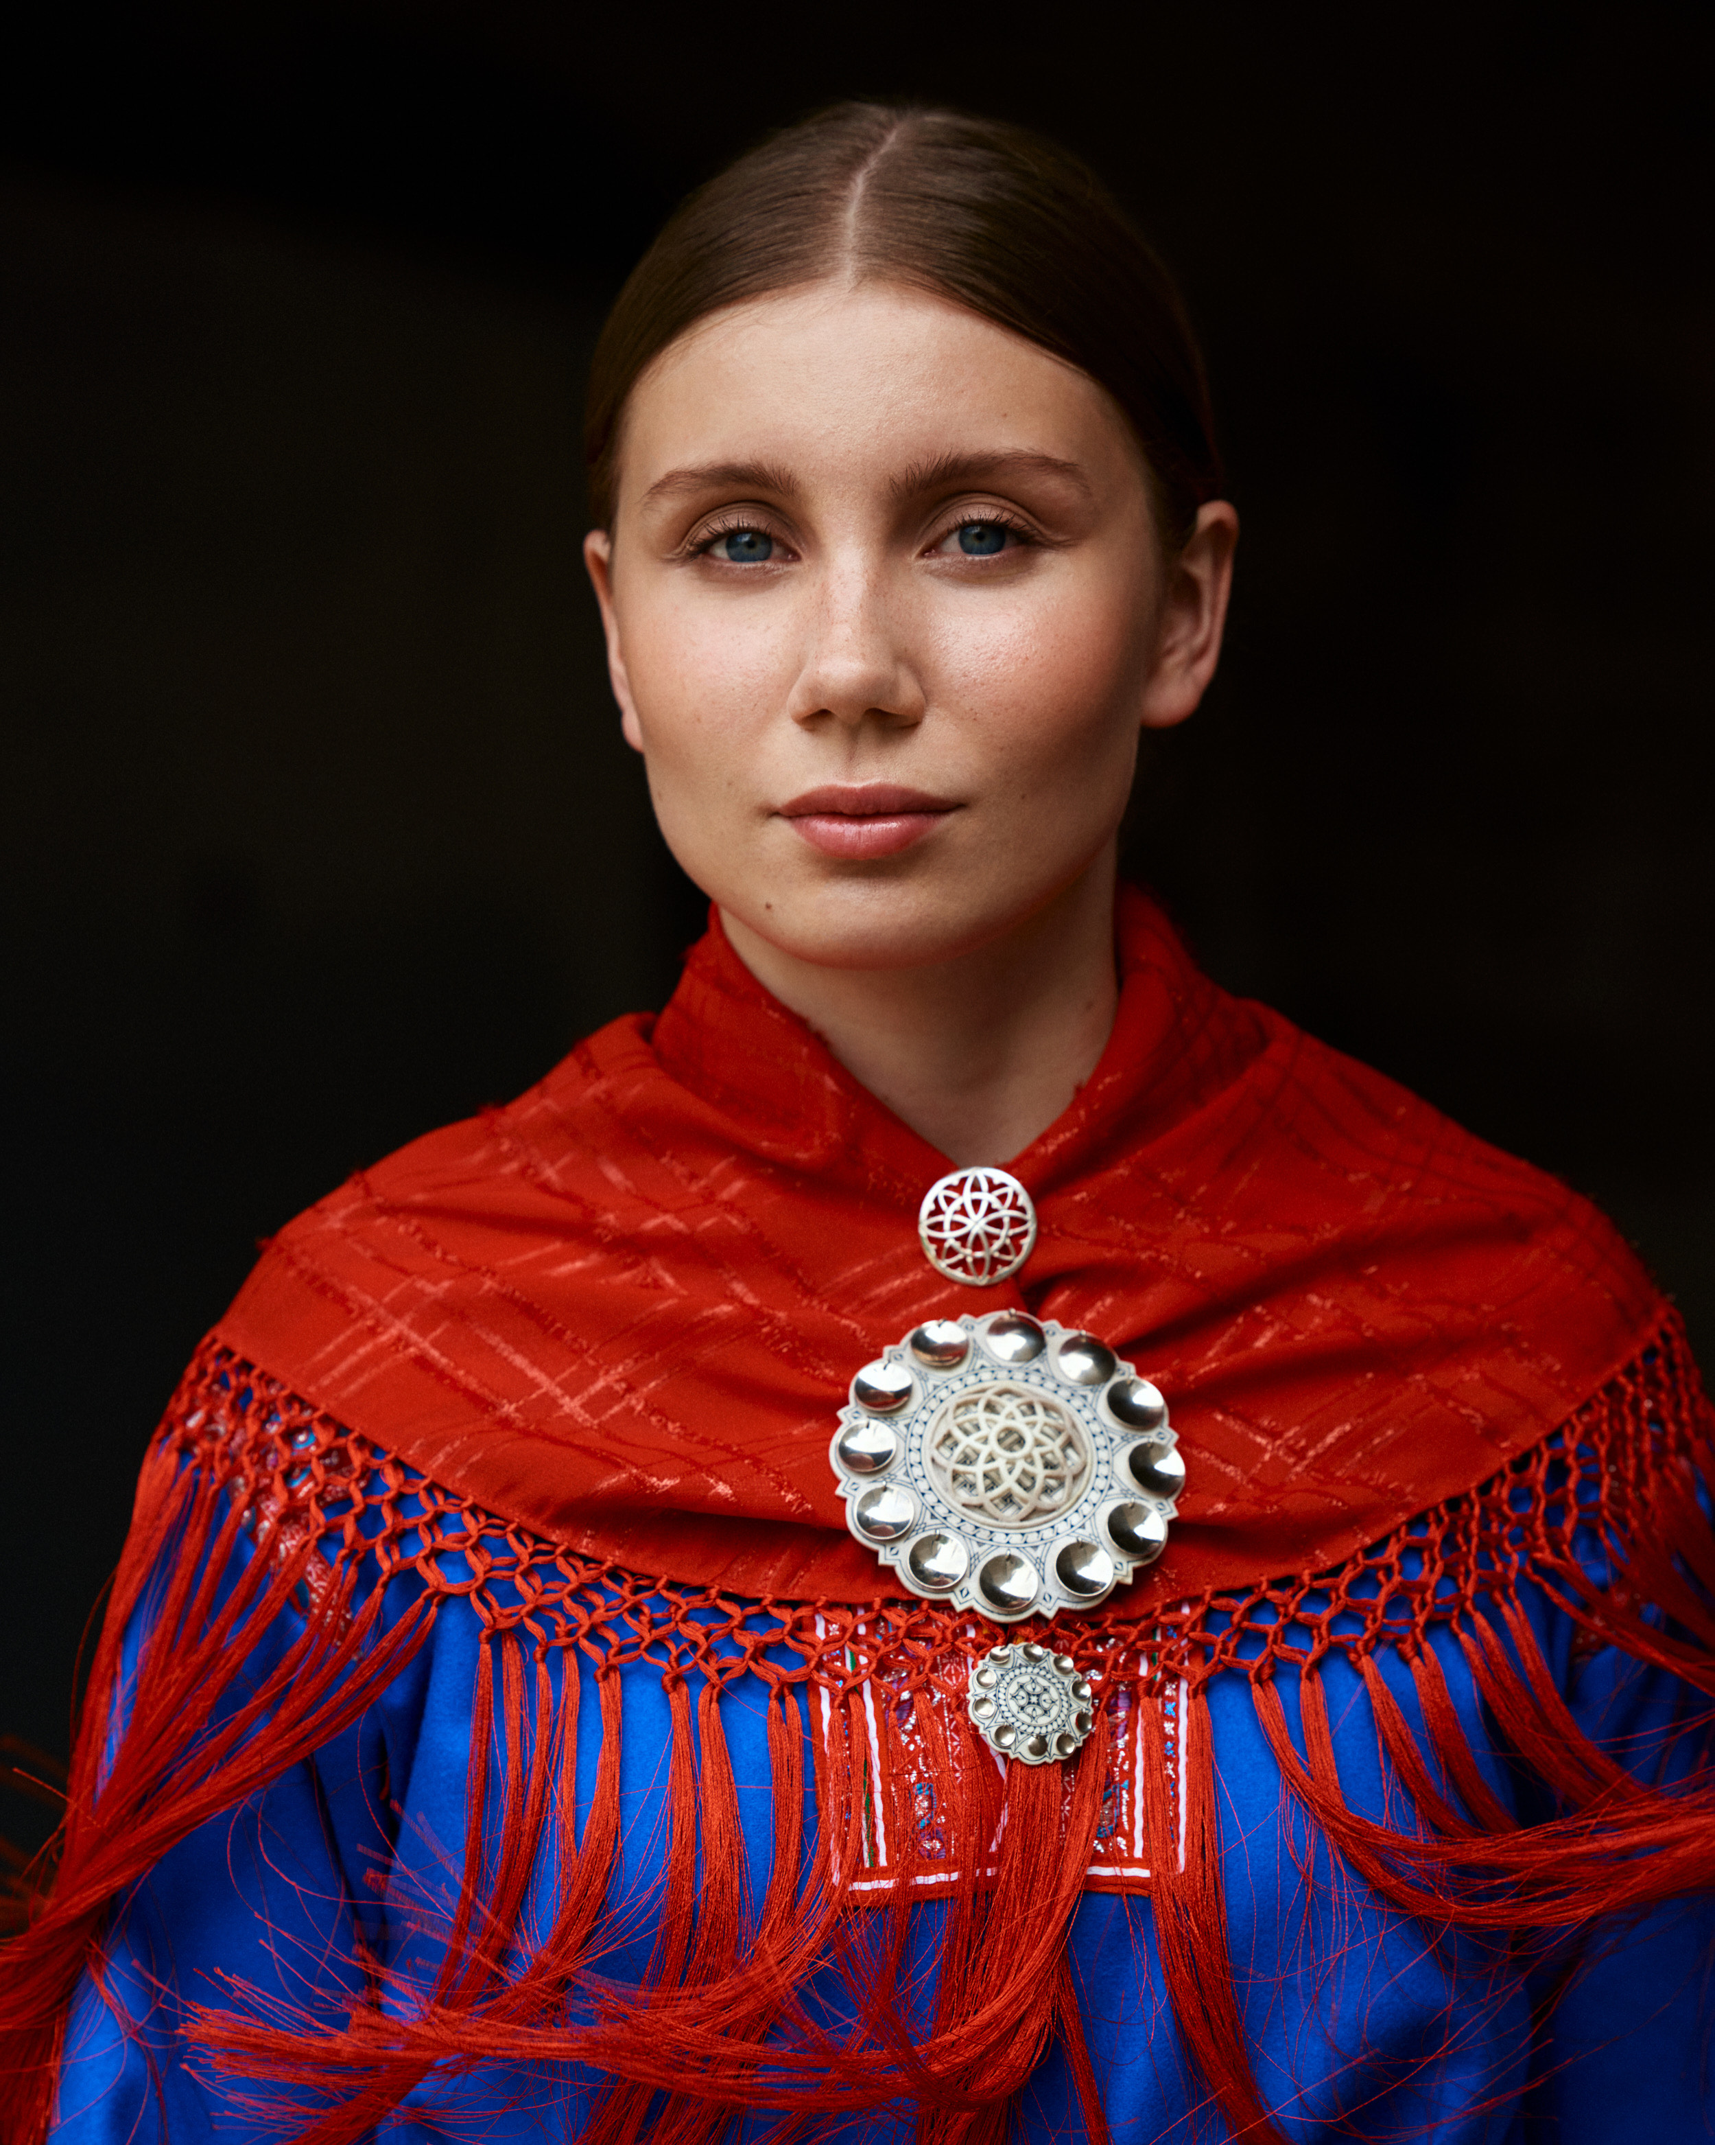
Racism and discrimination
QUOTE
«In a few generations the language of my heart will likely be extinct»
– Ella Maria Hætta Isaksen
What could be the consequences of a language becoming extinct?
© Sara Angelica Spilling 2021
Notes:
On the basis of a decision by UNESCO in 2019 the UN has declared the period 2022-2032 as the international decade for indigenous languages.
Follow-up questions:
How would you react if you were not allowed to speak your mother tongue and all public communication had to be done in Norwegian?
Do you think you would communicate the same way if you were only allowed to speak Norwegian in public?
Why do you think the UN declared a decade for indigenous languages?
Does the Norwegian majority population have any responsibility in making sure Sámi languages survive and develop?

Slide 35
Racism and discrimination
FACT
In 1898 «Wexelsenplakaten» was implemented, which ensured a near total ban on the use of Sámi and Kven languages in school.
Wexelsenplakaten is repealed in 1959. In 1967 school lessons were held in Sámi for the first time in approximately 100 years.
In 1992 the Sámi language-law is implemented. This entails the right to communication in Sámi in local public institutions in parts of Norway.
How does this relate to the status of Sámi languages today?
snl.no / samiskeveivisere.no
Notes:
The Norwegian education law gives elementary school children in Sámi districts the right to their education held in Sámi. All Sámi upper secondary students have the right to education held in Sámi.
One discriminatory accusation is that some Sámi people have been subjected to when they speak Sámi in public is that they are gossiping and conspiring against those around them who do not speak Sámi. This is one of many prejudices which contributes to weakening the visibility and development of Sámi languages.
Even though we have come a long way since the time of Wexelsensplakaten, there are still serious social challenges related to speaking Sámi in school and otherwise in public.
Follow-up questions:
In which ways can the lack of access to information in own’s native language be discriminatory?
Which consequences may it have that one is discriminated against on the basis of one’s native language?
Does the Norwegian majority population have any responsibility in making sure Sámi languages survive and develop?

Slide 36
Racism and discrimination
CASE
Reindeer herding is discussed in social media. In the comment section you find several people commenting that Sámi people whine too much.
Do you think there would be as many of these type of comments if the topic that was being discussed was about the rights and culture of majority Norwegians?
Notes:
Reindeer herding is a central part of Sámi culture. Prejudices against Sámi reindeer herding is one of the many challenges facing Sámi culture. Loss of nature, climate change and predators are all factors that play a role in the threat against reindeer herding. It is important to understand that the fight for reindeer herding does not end with stopping harassment. Knowledge about the different challenges facing herding, and a will to meet these challenges head on are also important to the industry.
Follow-up questions:
How is reindeer herding connected to the culture and rights of the Sámi people?
How do you think if you had to defend yourself against such opinions in the comment section?
How does it matter that the comments are about an entire minority population?

Slide 37
Racism and discrimination
CASE
It has just been decided that a wind-mill park will be developed in Marie’s Sámi community, and she experiences that many people ask her if «all Sámis are against the green shift?»
How do you interpret this question?
Notes:
This scenario is meant to contribute to reflection on the stereotypes related to Sámi perspectives on environmentalism/development of power plants in their communities. This case should be read openly without any indication of what «Marie’s» actual opinions are.
The focus should rather be on how she is being spoken to as a representative of the myth «Sámi’s are against environmentalism» (http://samiskmyteknuser.no/myte-4/), as well as the tendency to interpret one individual as representative for their entire culture.
Follow-up questions:_
Do you have underlying prejudices such as this?
What can be the reason that some Sámi individuals are against wind powered plants?
What is the problem with making one individual responsible for a stereotype regarding their own ethnic group?

Slide 38
Racism and discrimination
CASE
You overhear a conversation between to people at a party. One of them makes a joke about Sámi. The other person says they are Sámi themself and do not think it is OK to make jokes about other people’s identity. The first person then says «Relax. It was just a joke. You Sámi are always so fragile».
How would you react to this conversation?
Notes:
This card is meant to contribute to reflection around stereotypes and discriminatory expressions which are «normalized» through jokes.
Follow-up questions:
How would you react if you overheard this conversation?
Does it matter that the person who joked belongs to the ethnic majority in Norway?
Does context matter when it comes to jokes about ethnic belonging?

Slide 39
Racism and discrimination
AMNESTY BELIEVES
...that everyone is entitled to express their cultural, traditional or religious background by the clothes they wear. Also, no one is to be forced to dress in a certain way. However, general clothing prohibitions that violate the freedom of people who wish to dress a certain way, is not the way to go about to prevent this.​
Notes:
Example: In 2016 France moved to forbid the Burkini (swimsuit which covers the entire body).
Amnesty believes that this was an attack on womens’ right to freedom of expression and freedom of religion. After much criticism from Amnesty and other parties the French supreme court revoked this decision.

Slide 40
Racism and discrimination
Rasisme og diskriminering
AMNESTY BELIEVES
…that prohibiting discrimination is a central principle in human rights. We highlight that all humans have the same rights, regardless of, for instance:
Religion and faith
Gender
Functional ability
Ethnicity and nationality
Political standing
Social background and language
Sexual orientation and gender identity
Age
Health
Notes:
Mention that this principle aligns with article 2 in the declaration of human rights.
ART 2. EQUAL RIGHTS FOR ALL
No one should be discriminated against because of their age, religion, gender, ethnicity, life situation or other factors.

Slide 41
Racism and discrimination
Rasisme og diskriminering
What can you do to prevent racism and discrimination?
Notes:
Read the question out loud. Give the pupils time to reflect on the question and let every participant answer in plenary.
This card is meant to sum up the dialogue and is necessary to achieve the learning outcome of the activity. This card is therefore meant to be presented last.

Slide 42

SUMMARY
Racism and discrimination
Notes:
The pupils or groups will now share their summarizing thoughts in plenary.
After the pupils have summarized their thoughts, the moderator could highlight a few bulletpoints/thoughts that have come up often during the dialogue.
Feel free to ask follow-up questions during the summary:
What made the biggest impression during this activity?
Are you more aware of your own opinions and values now?
What is the most important thing you will take with you from this activity?
What can you and I do to combat racism and discrimination?

Slide 43
Racism and discrimination
Rasisme og diskriminering
Has anyone changed their mind?
Notes:
Show the statement again and ask if anyone has changed their opinion or has anything new to add. Show the statement on the next slide, repeat it loudly and take answers in plenary.

Slide 44
Racism and discrimination
Rasisme og diskriminering
STATEMENT
A world without racism is possible
Notes:
Read the statement out loud again. Any new thoughts to add now after the dialogue?
For the teacher/moderator: this statement is meant to promote an understanding of the fact that racisms exists on different levels, and why it is important to combat this. The goal is that the pupils, throughout the dialogue, reflect around and increase their understanding of
What racism is
Which groups are subject to it
How to prevent racism and prejudice in ones own circle

Slide 45
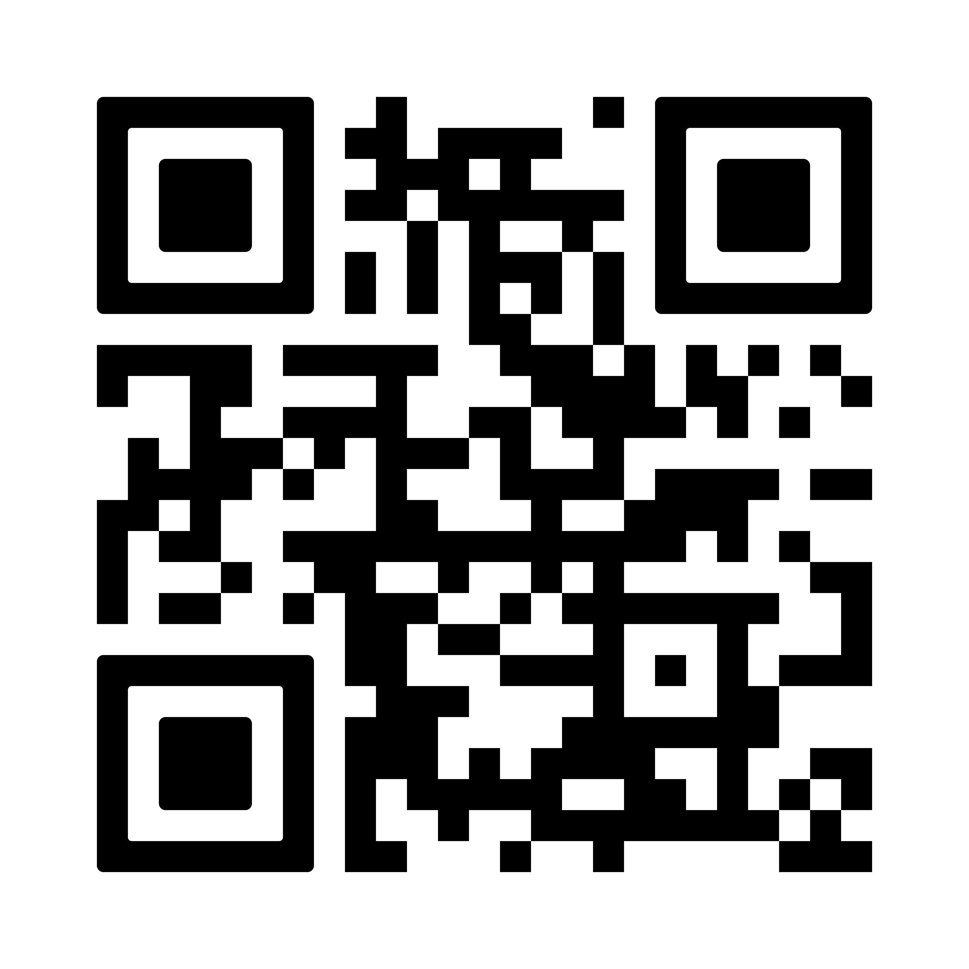

HOW CAN YOU COMBAT RACISM AND DISCRIMINATION?
Learn more about the topic https://www.amnesty.org/en/what-we-do/discrimination/
Speak up when you witness discrimination
Discuss racism and discrimination in your community
Become a member of an organisation that works to combat racism and discrimination
You can report any experienced or witnessed racism in Norway here: https://antirasistisk.no/
Notes:
To join Amnesty in their work against racism and discrimination become an Amnesty activist: https://amnesty.no/engasjer-deg
For increased knowledge of the topic feel free to explore the following:
Movies:
Unknown (1989) Do the right thing
https://www.imdb.com/title/tt0097216/
Netflix (2019) ‘When they see us’
https://www.imdb.com/title/tt7137906/?ref_=nv_sr_srsg_0
Articles:
Amnesty (2020) ‘Deadly force and police brutality’
Amnesty (2014): ON THE STREETS OF AMERICA: HUMAN RIGHTS ABUSES IN FERGUSON (2014)
Amnesty (2015) ‘DEADLY FORCE POLICE USE OF LETHAL FORCE IN THE UNITED STATES’
Fafo (2019) Holdninger til diskriminering, likestilling og hatprat i Norge
Minotenk (2018) ‘Muslimfiendtlige holdninger i Norge’
Video/ klipp
David Ikard (2018) ‘The real story of Rosa Parks and why we need to confront myths about black history.
Amnesty Poland (2016) ‘Look beyond borders: 4 minute experiment’.
https://www.youtube.com/watch?v=iqGWFSE6bmU
Bøker
David Ikard (2013) ‘Blinded by the Whites (Blacks in the Diaspora)’
Minotenk (2020) Skal liksom liksom-passet ditt bety noe? Resume finner du her: https://minotenk.no/skal-liksom-liksom-passet-ditt-bety-noe/

Slide 46
Notes:
Do you wish to contact Amnesty about this lesson? Contact us at opplaering@amnesty.no

